Slide 1
UNIT 1: DIODE & APPLICATIONS
By Dr Shivani Sharma
PN junction diode: Working Principle, V-I Characteristics, Rectifiers - Half Wave & Full Wave, PIV, Ripple Factor and Efficiency, Clippers & Clampers Special Purpose Diodes: Construction, Characteristics and Applications - Tunnel Diode, Schottky Diode, Varactor Diode, Photodiode, Zener Diode

Slide 2
Classification of Energy Bands
Valence Band
The electrons in the outermost shell are known as valence electrons. These valence electrons contain a series of energy levels and form an energy band known as the valence band. The valence band has the highest occupied energy.
Conduction Band
The valence electrons are not tightly held to the nucleus due to which a few of these valence electrons leave the outermost orbit even at room temperature and become free electrons. The free electrons conduct current in conductors and are therefore known as conduction electrons. The conduction band is one that contains conduction electrons and has the lowest occupied energy levels.
Forbidden Energy Gap
The gap between the valence band and the conduction band is referred to as the forbidden gap. As the name suggests, the forbidden gap doesn’t have any energy and no electrons stay in this band. If the forbidden energy gap is greater, then the valence band electrons are tightly bound or firmly attached to the nucleus. We require some amount of external energy that is equal to the forbidden energy gap.

Slide 3
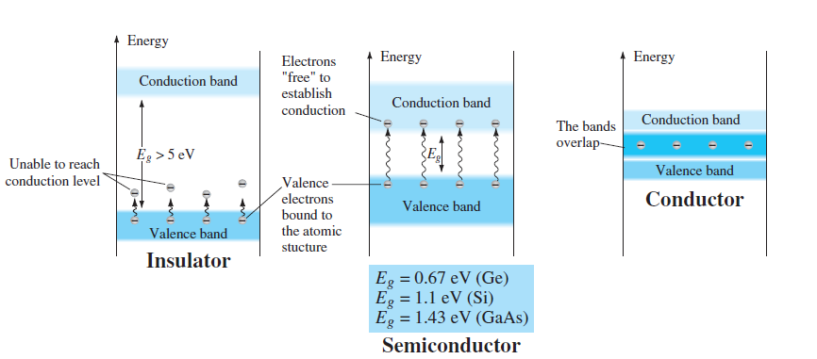
ENERGY BAND
Conductors: Gold, Aluminum, Silver, Copper, all these metals allow an electric current to flow through them. There is no forbidden gap between the valence band and conduction band which results in the overlapping of both the bands. The number of free electrons available at room temperature is large.
Insulators: Glass and wood are examples of the insulator. These substances do not allow electricity to pass through them. They have high resistivity and very low conductivity. The energy gap in the insulator is very high up to 7eV.
Semiconductors: Germanium and Silicon are the most preferable material whose electrical properties lie in between semiconductors and insulators. The energy band diagram of semiconductors is shown where the conduction band is empty and the valence band is completely filled but the forbidden gap between the two bands is very small

Slide 4
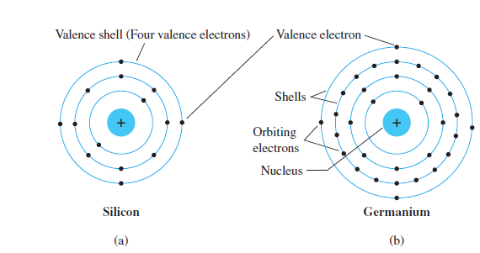
Silicon has 14 orbiting electrons, germanium has 32 electrons, gallium has 31 electrons, and arsenic has 33 orbiting electrons. For germanium and silicon there are four electrons in the outermost shell, which are referred to as valence electrons.

Slide 5
Why is silicon preferred over germanium?
Greater Heat Resistance
Another area where silicon is superior to germanium is heat resistance. Silicon can withstand up to 150 degrees Celsius or roughly 300 degrees Fahrenheit.
On the other hand, germanium wafers are prone to breakage or melting at 70 degrees Celsius or 158 degrees Fahrenheit.
Silicon processors are ideal for computers because of their heat resistance. Although it degrades performance, these chips can continue to operate beyond germanium’s heat tolerance levels without suffering material damage.

Slide 6
SEMICONDUCTOR MATERIALS
The construction of every discrete (individual) solid-state (hard crystal structure) electronic device or integrated circuit begins with a semiconductor material of the highest quality. Semiconductors are a special class of elements having a conductivity between that of a
good conductor and that of an insulator.
In general, semiconductor materials fall into one of two classes: single-crystal and compound. Single-crystal semiconductors such as germanium (Ge) and silicon (Si) have a repetitive crystal structure, whereas compound semiconductors such as gallium arsenide (GaAs), cadmium sulfide (CdS), gallium nitride (GaN), and gallium arsenide phosphide (GaAsP) are constructed of two or more semiconductor materials of different atomic structures.
Unlike conductors, the charge carriers in semiconductors arise only because of external energy (thermal agitation). It causes a certain number of valence electrons to cross the energy gap and jump into the conduction band, leaving an equal amount of unoccupied energy states, i.e., holes. The conduction due to electrons and holes is equally important.
Fact: The three semiconductors used most frequently in the construction of electronic devices are Ge, Si, and GaAs.

Slide 7
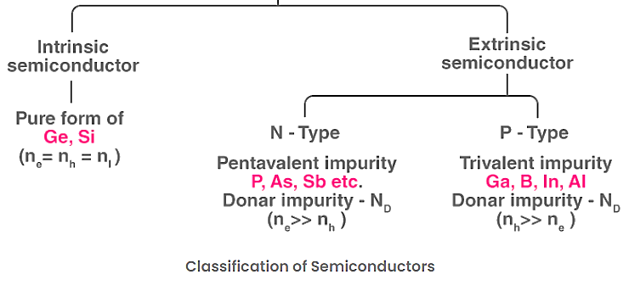
SEMICONDUCTORS

Slide 8
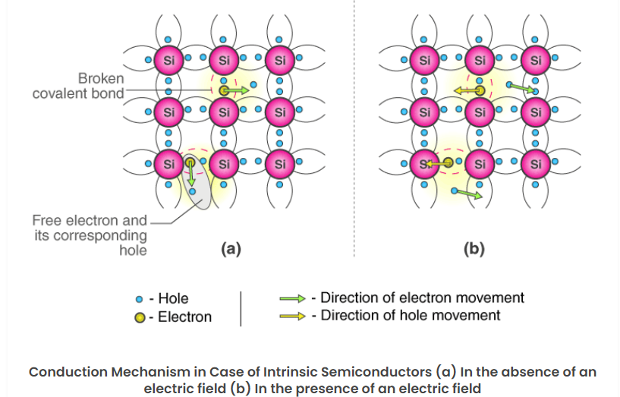
Intrinsic Semiconductor: An intrinsic type of semiconductor material is made to be very pure chemically. It is made up of only a single type of element.

Slide 9
Extrinsic Semiconductor
The conductivity of semiconductors can be greatly improved by introducing a small number of suitable replacement atoms called IMPURITIES. The process of adding impurity atoms to the pure semiconductor is called DOPING. Usually, only 1 atom in 10⁷ is replaced by a dopant atom in the doped semiconductor. An extrinsic semiconductor can be further classified into types:
N-type Semiconductor: An n -type material is created by introducing impurity elements that have five valence electrons ( pentavalent ), such as antimony , arsenic , and phosphorus.
P-type Semiconductor: The p -type material is formed by doping a pure germanium or silicon crystal with impurity atoms having three valence electrons. The elements most frequently used for this purpose are boron , gallium , and indium .

Slide 10
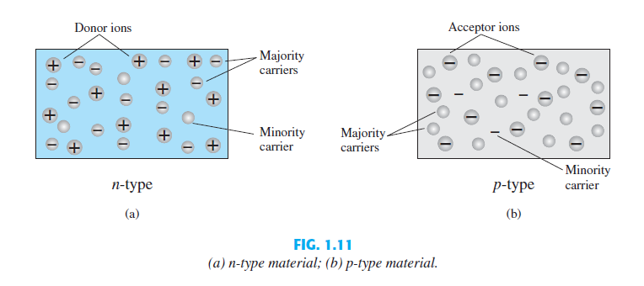

Slide 11
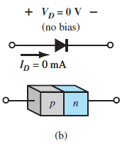
Semiconductors Diode or PN Junction Diode
A semiconductor diode is a p-n junction diode. It is a two-terminal device that conducts current only in one direction.
Structure: A PN diode consists of two regions: P-type (positive) and N-type (negative) semiconductor materials, joined together.
Junction: The interface between the P-type and N-type regions is called the PN junction/depletion region.
Function: It allows current to flow in one direction (forward bias) and blocks it in the opposite direction (reverse bias).
MODE OF OPERATION:
No bias/Unbias
Forward bias
Reverse bias .

Slide 12
1. NO BIAS V= 0, I= 0
This region of uncovered positive and negative ions is called the depletion region due to the “depletion” of free carriers in the region.
If leads are connected to the ends of each material, a two-terminal device. the applied voltage is 0 V (no bias) and the resulting current is 0 A, much like an isolated resistor. The absence of a voltage across a resistor results in zero current through it.
Under no-bias conditions, any minority carriers (holes) in the n -type material that find themselves within the depletion region for any reason whatsoever will pass quickly into the p -type material.
Recombination: The closer the minority carrier is to the junction, the greater is the attraction or the layer of negative ions and the less is the opposition offered by the positive ions in the depletion region of the n -type material.

Slide 13
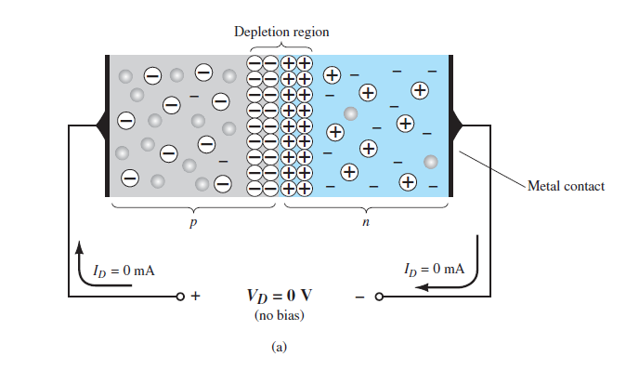
The depletion layer forms at the PN junction where the P-type and N-type materials meet. When these materials are joined, electrons from the N-type region (which have a negative charge) diffuse into the P-type region and recombine with holes (which have a positive charge).
Depletion Region: This recombination creates a region around the junction that is depleted of free charge carriers (electrons and holes). This area is called the depletion region or space charge region.
Electric Field: The movement of electrons and holes creates an electric field across the depletion region. This field is oriented from the N-type side to the P-type side and creates a built-in potential barrier.

Slide 14
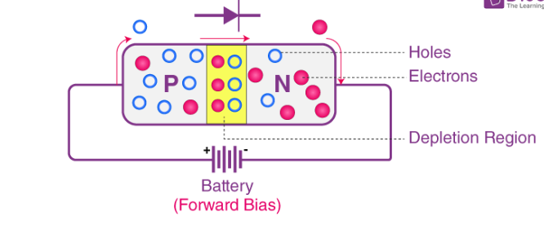
2. FORWARD BIASED V> 0, I is generated
When a forward voltage is applied (P-side connected to positive and N-side to negative), the external voltage reduces the potential barrier, allowing charge carriers to cross the junction, thus enabling current to flow.
In forward biasing, the positive terminal of the power supply is connected to the P-type material (anode) and the negative terminal to the N-type material (cathode) of the diode.
When the forward voltage exceeds the threshold voltage (typically around 0.7V for silicon diodes), the barrier is sufficiently lowered, allowing charge carriers (electrons and holes) to cross the junction and flow through the diode. This results in significant forward current flow.

Slide 15
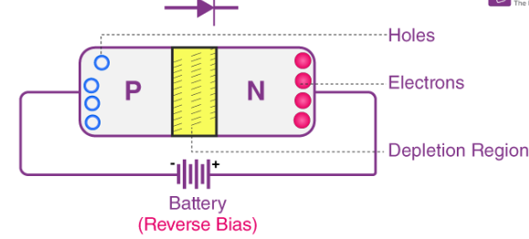
When a reverse voltage is applied (P-side connected to negative and N-side to positive), the potential barrier is increased, widening the depletion region and preventing the flow of current, except for a small leakage current.
Depletion Region Expansion: The width of the depletion region increases as the reverse voltage is applied, which further restricts the movement of charge carriers.
Current Flow: Under reverse bias, the diode ideally conducts a very small leakage current due to minor thermally generated carriers. The diode effectively blocks significant current flow
Reverse Breakdown: If the reverse voltage exceeds a certain level (reverse breakdown voltage), the diode may enter breakdown mode, leading to a sharp increase in current. This is usually undesirable in most diodes except in specialized ones like Zener diodes designed to operate in breakdown conditions. The current that exists under reverse-bias conditions is called the reverse saturation current.
3. REVERSE BIASED V< 0, Io is generated

Slide 16
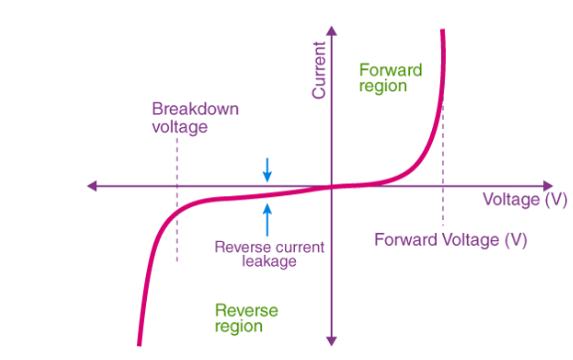
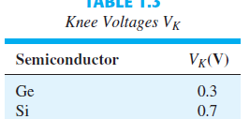
V-I CHARACTERISTICS OF PN DIODE
The maximum reverse-bias potential that can be applied before entering the breakdown region is called the peak inverse voltage (referred to simply as the PIV rating) or the peak reverse voltage (denoted the PRV rating).

Slide 17
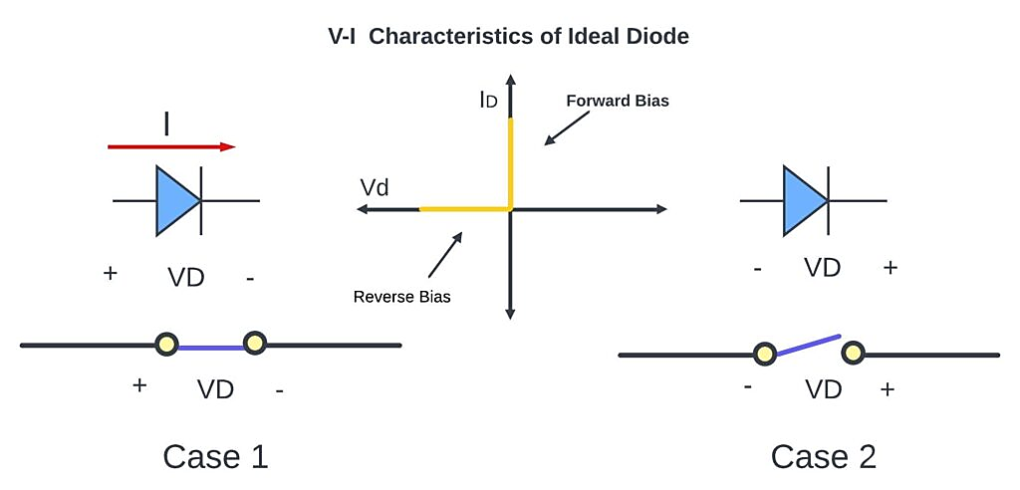

IDEAL DIODE ACT AS A SWITCH
An ideal diode is a diode that has all of its properties perfectly without any flaws. Diodes may operate either forwardly or reversely biased. During forward bias, an Ideal Diode acts like a perfect conductor, while when reverse-biased, it acts like an ideal insulator. This means that the ideal diode offers zero resistance in forward bias and infinite resistance in reverse bias.

Slide 18
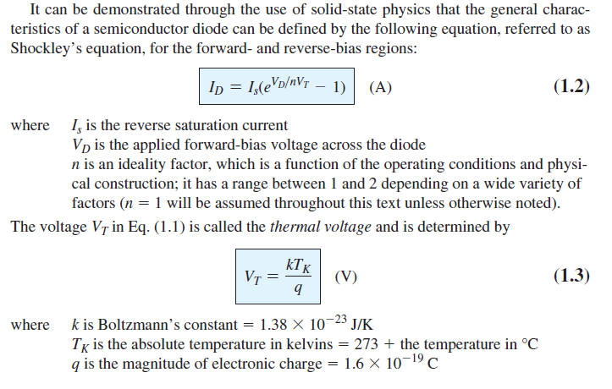

Slide 19
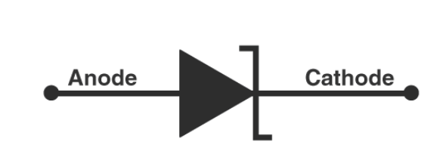
ZENER DIODE
There are two types of breakdowns in a Zener Diode: Avalanche Breakdown (gradual breakdown) and Zener Breakdown (sudden).
Zener diodes are semiconductor devices that allow current to flow in both directions but specialize in current flowing in reverse. Also known as breakdown diodes, Zener diodes are the most common electronic components used as stable voltage references for electronic circuits.

Slide 20
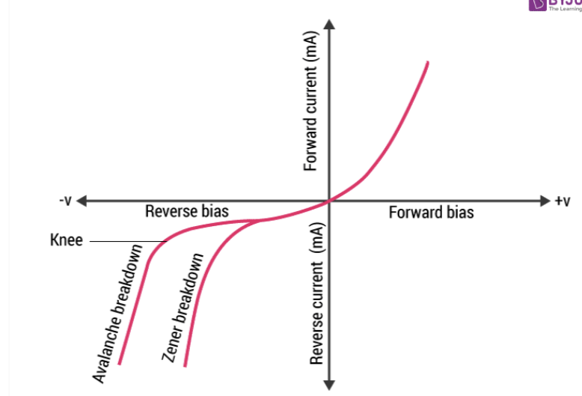
Zener/Breakdown Voltage
Occurred when a heavily doped junction is reverse biased.
This is observed at VZ< -6 V.
Breaking of covalent bonds is due to intense electric field across the narrow depletion region. This generates large number of free electrons to cause breakdown.
V-I characteristics with Zener breakdown is very sharp.
Negative temperature coefficient. (When T increases VZ decreases )
Avalanche Breakdown-
Occurred when a lightly doped junction is reverse biased.
This is observed at VZ < -8 V
Breaking of covalent bonds is due to collision of accelerated charge carriers having large velocities and kinetic energy with adjacent atoms. The process is called carrier multiplication.
This V-I characteristics with the avalanche breakdown increases gradually.
Positive temperature coefficient of voltage. (When T increases VZ increases).

Slide 21
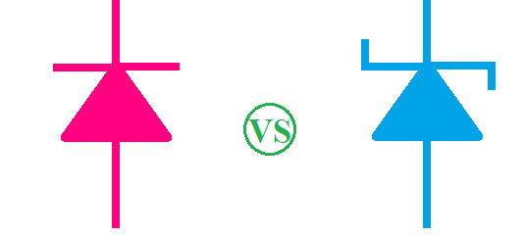
PN DIODE V/S ZENER DIODE
Feature | PN Junction Diode | Zener Diode
Primary Operation | Forward bias | Reverse bias
Doping Level | Moderately doped | Highly doped
Depletion Width | Relatively wide | Narrow
Breakdown Voltage | High | Low, specific Zener voltage (Vz)
Primary Application | Rectification, clipping, and clamping | Voltage regulation and voltage reference
Current Flow | Primarily one direction (forward) | Two directions (forward and reverse breakdown)
Resistance in Reverse Bias | Very high | Very low (after breakdown)
Characteristics | Conducts in the first quadrant of the V-I curve | Conducts in the third quadrant of the V-I curve (reverse)

Slide 22
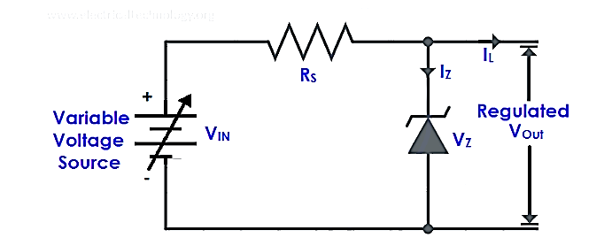
Zener Diode as a Voltage Regulator/Shunt Regulator: O/P voltage is constant irrespective of I/P
A voltage regulator is a device that regulates the voltage level. It essentially steps down the input voltage to the desired level and keeps it at that same level during the supply. This ensures that even when a load is applied the voltage doesn’t drop. The voltage regulator is used for two main reasons, and they are:
  To vary or regulate the output voltage
  To keep the output voltage constant at the desired value in spite of variations in the supply voltage.
  Zener diode in over-voltage protection, Zener diode is used as for meter protection against damage from accidental application of excessive voltage

Slide 23
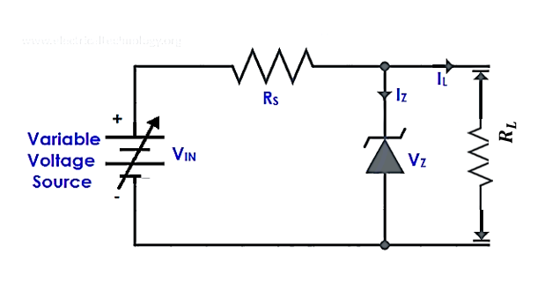

Zener Diode as a Voltage Regulator
To check the status of Diode first assume Diode is OFF & circuit is OC.
Then find Voc (V)
Voc = $\frac{Vi ∗ R_{L}}{R+R_{L}}$
If Voc ≥Vz , ZD is ON (Closed switch, replace it with battery)
If Voc ≤ Vz , ZD is OFF (Open switch)

Slide 24
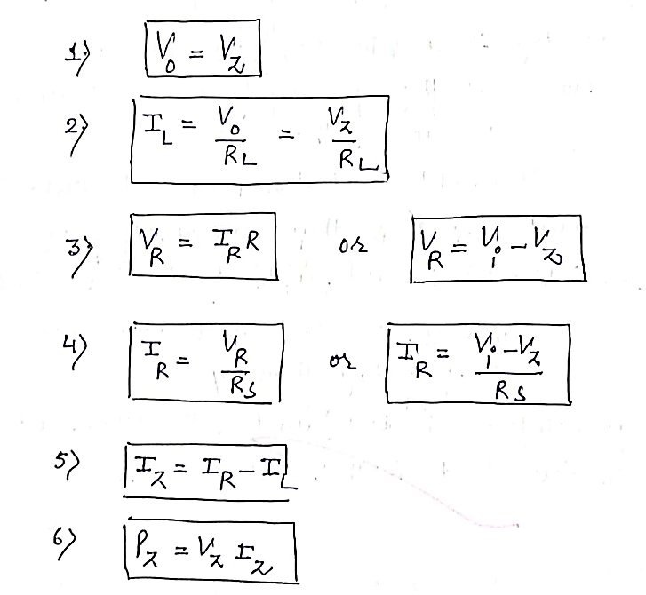
Zener Diode is ON

Slide 25
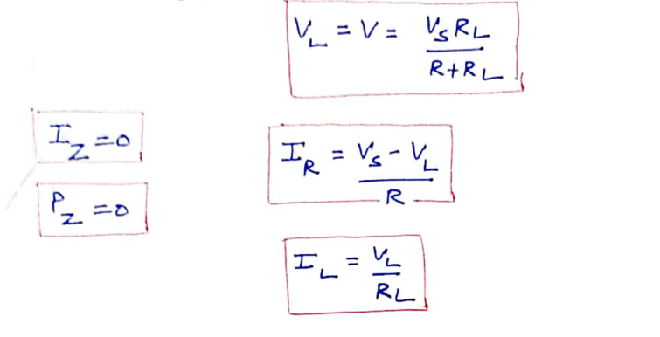
Zener Diode is OFF

Slide 26
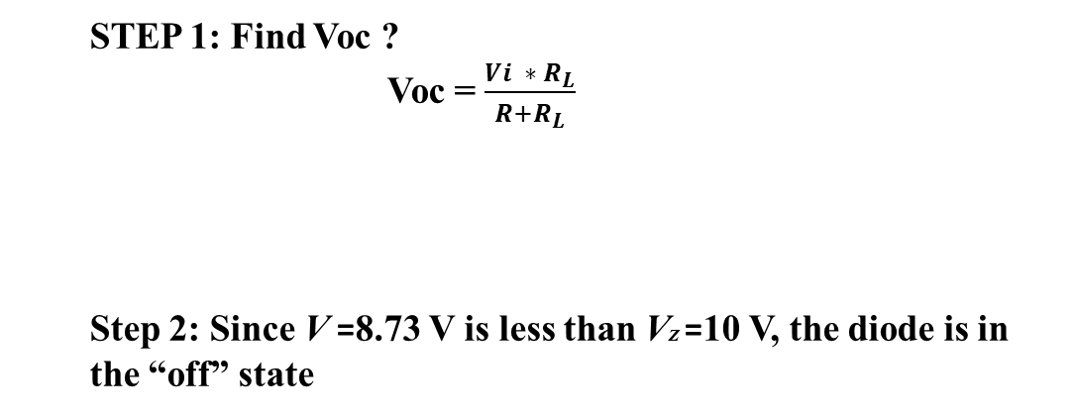
Q.1 For the Zener diode network (a) determine VL, VR, IZ, and PZ. (b) with Load resistor = 3 kΩ
STEP 1: Find Voc ?
Voc = $\frac{Vi ∗ R_{L}}{R+R_{L}}$
Step 2: Since V =8.73 V is less than VZ =10 V, the diode is in the “off” state
FIXED V & R CASE

Slide 27
(b) with RL = 3 kΩ
Since V =12 V is greater than VZ = 10 V, the diode is in the “on” state
FIXED V & R CASE

Slide 28
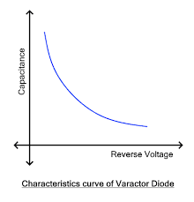
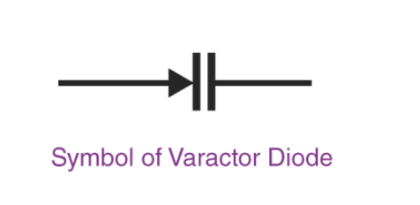
SPECIAL PURPOSE 2T DEVICES: VARACTOR, TUNNEL,SCHOTTKY, PHOTO, LED
Varactor Diode: Also called Varicap , Volt cap, Voltage variable capacitance, or Tunning diode. One end of the symbol consists of the diode, and the other has two parallel lines representing the capacitor’s conductive plates. The gap between the plates shows their dielectric.
Function: A varactor diode is a semiconductor diode whose capacitance varies with the voltage applied across its terminals. It is commonly used in RF circuits as a voltage-controlled capacitor.
Construction: It consists of a p-n junction with a reverse bias applied. The depletion region acts as the dielectric of the capacitor, and the p and n regions act as the plates.
Applications: Varactors are used in frequency modulation (FM) applications, voltage-controlled oscillators (VCOs).
Key Characteristics:
  High Q-factor at high frequencies.
  Capacitance decreases as the reverse bias increases.
  Low noise characteristics.
Notes:
C= AE/W

Slide 29
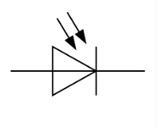
Photodiodes are a class of diodes that converts light energy to electricity. Their working is exactly the opposite of LEDs which are also diodes but they convert electricity to light energy. Function: A photodiode is a semiconductor device that converts light into an electrical current. The current is generated when photons are absorbed in the photodiode, creating electron-hole pairs.
A photodiode is subjected to photons in the form of light which affects the generation of electron-hole pairs. If the energy of the falling photons (hv) is greater than the energy gap (E_{g}) of the semiconductor material, electron-hole pairs are created near the depletion region of the diode. The electron-hole pairs created are separated from each other before recombining due to the electric field of the junction. Now when an external load is connected to the system, a current flow is observed through it.
Applications: Used in light detection, optical communication systems, and solar cells.
Key Characteristics:
High sensitivity to light.
Fast response time.
Operates in photoconductive (reverse bias) or photovoltaic (zero bias) modes.

Slide 30
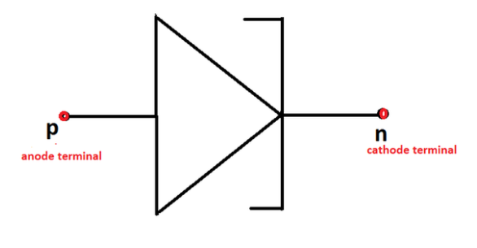
Tunnel Diode:
Function: A tunnel diode is a type of diode that has a negative resistance region due to quantum mechanical tunneling. It can operate at very high speeds, making it useful in high-frequency applications.
Construction: It consists of a heavily doped p-n junction, which causes the energy bands to overlap, allowing electrons to "tunnel" through the junction. Narrow depletion region due to high doping , width is inversely proportional to doping concentration.
Applications: Used in oscillators, amplifiers, and microwave frequency circuits.
Key Characteristics:
  Exhibits negative resistance, allowing it to amplify signals.
  Can operate at very high frequencies (GHz range).
  Low power consumption and highly reliable.
  No breakdown

Slide 31
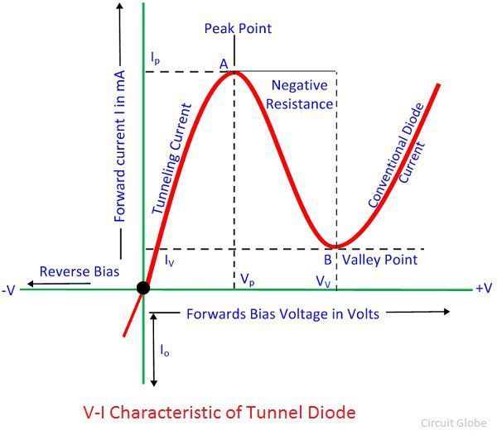
Ohmic region is zero to peak voltage (0 to Vp) . In ohmic region tunnel diode behaves like linear diode
Negative resistance region: (V>Vp) Biasing voltage is from peak voltage to the valley voltage.
Negative resistance in a tunnel diode is a region where an increase in voltage causes a decrease in current. This happens because of the tunneling effect, a quantum mechanics phenomenon that occurs when impurities are heavily doped into semiconductor materials. When voltage increases, electrons tunnel through the P-N junction barrier and fill electron states in the conduction band. However, as voltage increases further, the states become misaligned and the current drops
Saturation region:- If applied voltage is more than peak voltage(V>Vv)
The tunnel diode behaves like an ordinary diode, and show zero tunnel current and maximum diode current. If the applied voltage is greater than the voltage of the depletion layer the tunnel current start decreasing till the valley voltage level after that current increase exponentially.

Slide 32
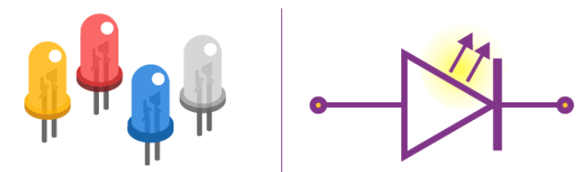
LED
A light-emitting diode (LED) is a semiconductor device that emits light when an electric current flows through it. When current passes through an LED, the electrons recombine with holes emitting light in the process. LEDs allow the current to flow in the forward direction and blocks the current in the reverse direction. The working of a photodiode is completely reversed to that of an LED. While an LED converts electrical energy into light (emits light), a photodiode converts light to electrical energy.
Construction: Made from direct bandgap materials like Gallium Arsenide (GaAs), LEDs have a p-n junction where the recombination of electrons and holes results in the emission of photons (light).
Applications: Widely used in displays, indicators, communication devices, and lighting.
Key Characteristics:
Emits light of specific wavelengths depending on the semiconductor material.
Energy-efficient and has a long lifespan.
Available in various colors (red, green, blue, etc.).

Slide 33
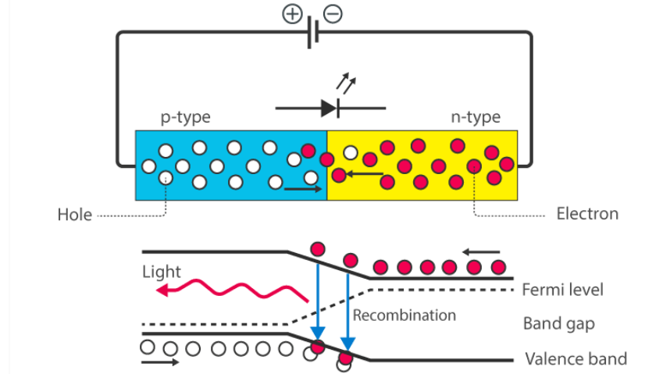
The energy is released in the form of photons on recombination. In standard diodes, the energy is released in the form of heat. But in light-emitting diodes, the energy is released in the form of photons. We call this phenomenon electroluminescence. Electroluminescence is an optical phenomenon, and electrical phenomenon where a material emits light in response to an electric current passed through it. As the forward voltage increases, the intensity of the light increases and reaches a maximum.

Slide 34
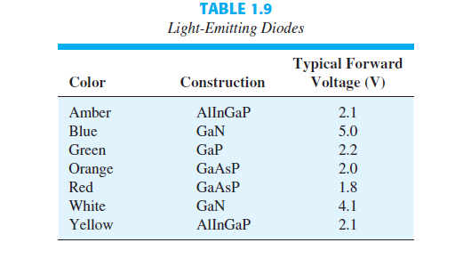

Slide 35
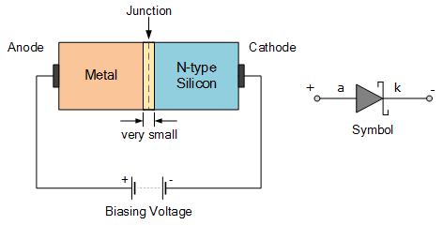
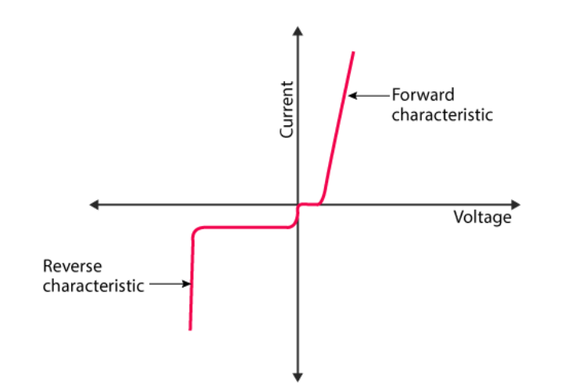
Schottky diode
The Schottky diode is a type of metal – semiconductor junction diode, which is also known as hot-carrier diode, low voltage diode or Schottky barrier diode. The Schottky diode is formed by the junction of a semiconductor with a metal. Schottky diode offers fast switching action and has a low forward voltage drop.
Working of a Schottky Diode
The operation relies on the principle that the electrons in different materials have different potential energy. N-type semiconductors have higher potential energy than electrons of metals.
When these two are brought into contact, there is a flow of electrons in both directions across the metal-semiconductor interface. A voltage is applied to the Schottky so that the metal is positive when compared to the semiconductor. The voltage opposes the built-in potential and makes the current flow easy.
The capacitance of the diode is low as the depletion region of the diode is negligible. The change from ON to OFF state is fast.The turn-on voltage of the diode is 0.2 to 0.3 volts, which is very low.

Slide 36
Diode as a Rectifier
A rectifier is an electrical component that converts alternating current (AC) to direct current (DC). A rectifier is analogous to a one-way valve that allows an electrical current to flow in only one direction.
The process of converting AC current to DC current is known as rectification. The main application of p-n junction diode is in rectification circuits.
Diode rectifier gives an alternating voltage which pulsates in accordance with time. The filter smoothes the pulsation in the voltage and to produce DC voltage, a regulator is used which removes the ripples.

Slide 37
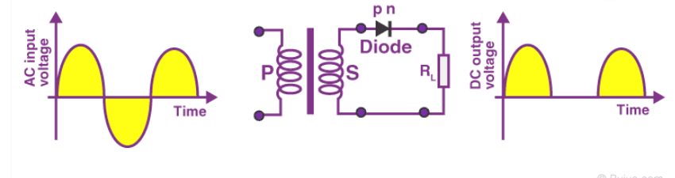
Half Wave Rectifier
When the p-n junction diode is forward biased, it gives little resistance and when it is reversed biased it provides high resistance. During one-half cycles, the diode is forward biased when the input voltage is applied and in the opposite half cycle, it is reverse biased.
A high AC voltage is applied to the primary side of the step-down transformer. The obtained secondary low voltage is applied to the diode.
The diode is forward biased during the positive half cycle of the AC voltage and reverse biased during the negative half cycle.
The final output voltage waveform is as shown in the figure below:

Slide 38
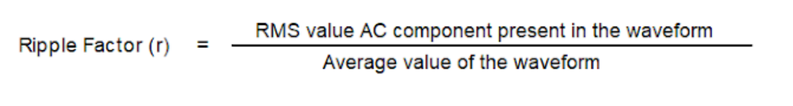
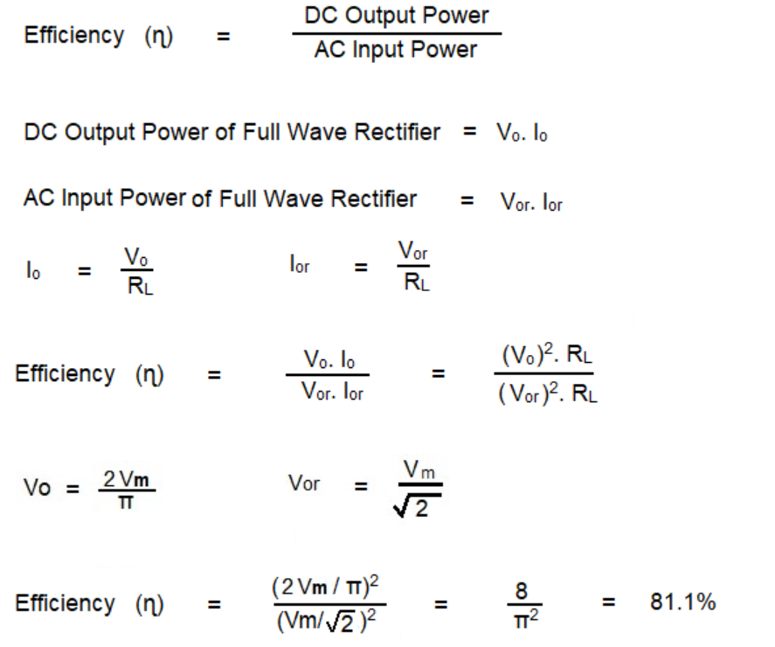



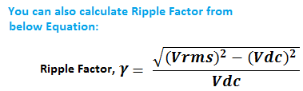
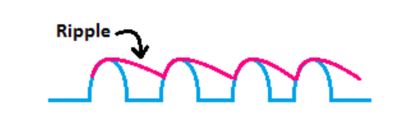
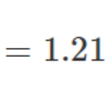
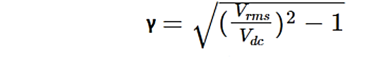
Ripple factor of HWR
The ratio of the RMS value of the AC component to the average value of the rectified output. The ripple factor is a dimensionless quantity that is always less than unity.

Slide 39
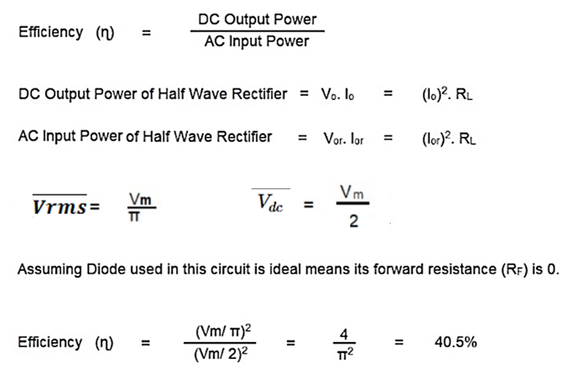
Efficiency : The efficiency of a halfwave rectifier is the ratio of output DC power to the input AC power.
The efficiency formula for halfwave rectifier is given as follows:

Slide 40
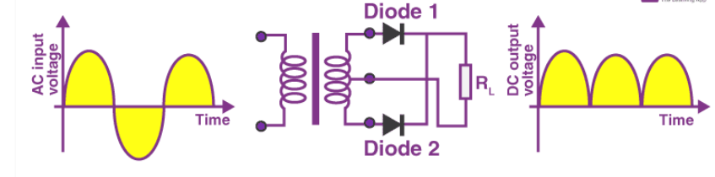
center tapped full wave rectifier
Full Wave Rectifier
Full-wave rectifier circuits are used for producing an output voltage or output current which is purely DC. The main advantage of a full-wave rectifier over half-wave rectifier is that such as the average output voltage is higher in full-wave rectifier, there is less ripple produced in full-wave rectifier when compared to the half-wave rectifier. the unwanted AC component that remains in the DC waveform after converting AC voltage to DC voltage. The ripple factor is a measurement of how well the HWR converts AC to DC, and how much ripple is in the output DC signal.

Slide 41
The anode of the center tapped diodes is connected to the transformer’s secondary winding and connected to the load resistor. During the positive half cycle of the alternating current, the top half of the secondary winding becomes positive while the second half of the secondary winding becomes negative.
During the positive half cycle, diode D₁ is forward biased as it is connected to the top of the secondary winding while diode D₂ is reverse biased as it is connected to the bottom of the secondary winding. Due to this, diode D₁ will conduct acting as a short circuit and D₂ will not conduct acting as an open circuit
During the negative half cycle, the diode D₁ is reverse biased and the diode D₂ is forward biased because the top half of the secondary circuit becomes negative and the bottom half of the circuit becomes positive. Thus, in a full wave rectifiers, DC voltage is obtained for both positive and negative half cycle.

Slide 42
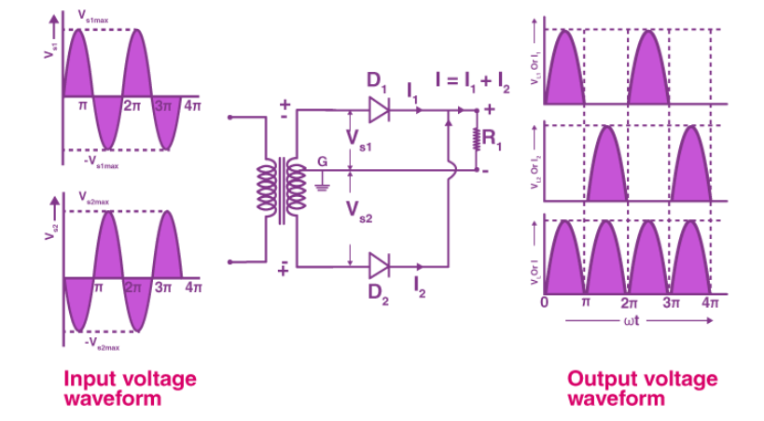

Slide 43

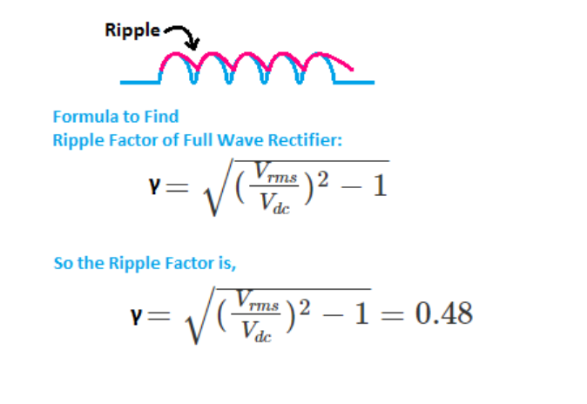
Ripple factor of FWR

Slide 45
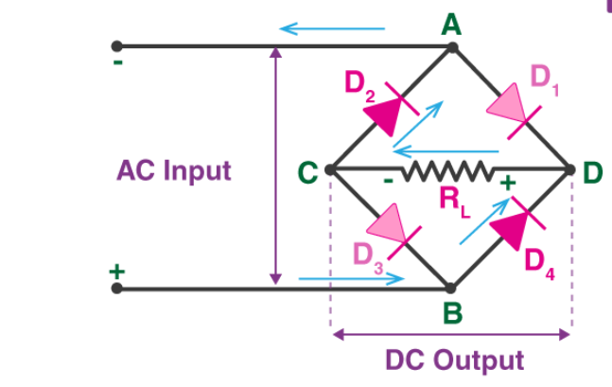
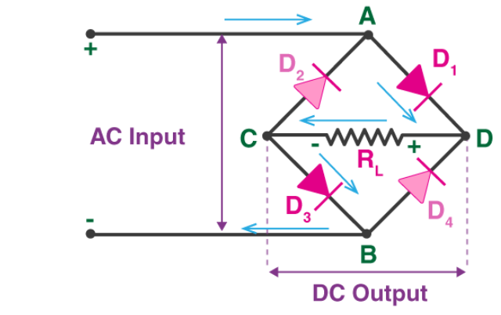
Bridge Rectifier: The construction of a bridge rectifier is shown in the figure below. The bridge rectifier circuit is made of four diodes D₁, D₂, D₃, D_{4,} and a load resistor R_{L}. The four diodes are connected in a closed-loop configuration to efficiently convert the alternating current (AC) into Direct Current (DC). D₁ and D₃ are pairs that conduct electric current during the positive half cycle. Likewise, diodes D₂ and D₄ conduct electric current during a negative half cycle.
The current flow during the positive half-cycle: When an AC signal is applied across the bridge rectifier, terminal A becomes positive during the positive half cycle while terminal B becomes negative. This results in diodes D₁ and D₃ becoming forward biased while D₂ and D₄ becoming reverse biased.
The current flow during the negative half-cycle: During the negative half-cycle, terminal B becomes positive while terminal A becomes negative. This causes diodes D₂ and D₄ to become forward biased and diode D₁ and D₃ to be reverse biased.

Slide 46
Feature | Half-Wave Rectifier | Full-Wave Rectifier (Centre-Tapped) | Full-Wave Bridge Rectifier
Number of Diodes | 1 | 2 | 4
Transformer Requirement | Optional | Required (center-tapped transformer) | Optional
Efficiency | ~40.6% | ~81.2% | ~81.2%
Peak Inverse Voltage (PIV) | Vm (maximum voltage of transformer) | 2Vm | Vm (for each diode)
DC Output Voltage | Vm/π | 2Vm/π | 2Vm/π
PIV | Vm | 2Vm | Vm
Ripple factor | 1.21 | 0.48 | 0.48
PIV refers to the maximum reverse voltage that a diode can withstand before it breaks down. It's essentially the peak voltage applied in the reverse direction.

Slide 47
Clamping
A circuit that clamps either the positive or negative peak of a signal at a desired D.C. level is known as a clamping.
A clamping adds D.C components to the signal and does not change the shape or amplitude of the input signal.
A Clamper Circuit is a circuit that adds a DC level to an AC signal. Actually, the positive and negative peaks of the signals can be placed at desired levels using the clamping circuits. As the DC level gets shifted, a clamper circuit is called as a Level Shifter.

Slide 48
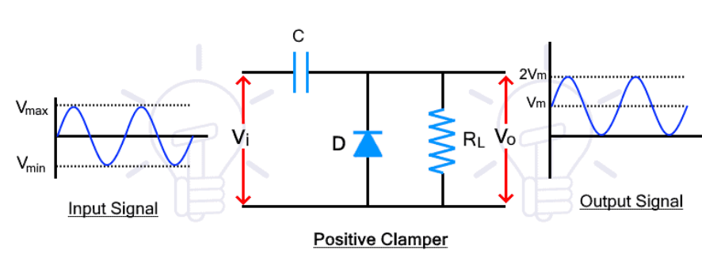
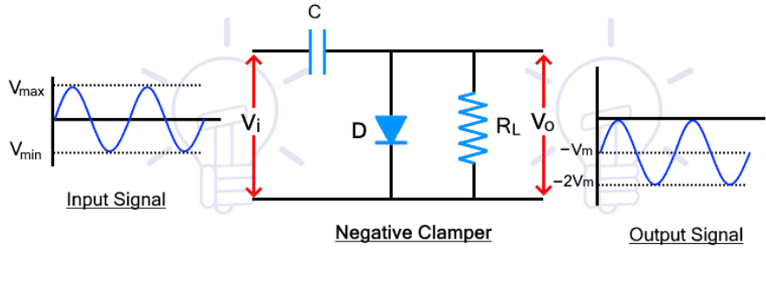
Unbiased Clampers Circuit
Positive Clampers
Negative Clampers
DURING -VE CYCLE: D is ON (short circuited), C will be charged to peak input voltage. Vo = 0 through ideal diode.
DURING + VE CYCLE: D is OFF (open circuited), output through will follow the input.
DURING +VE CYCLE: D is ON (short circuited), C will be charged to peak input voltage. Vo = 0 through ideal diode.
DURING - VE CYCLE: D is OFF (open circuited), output through will follow the input.

Slide 49
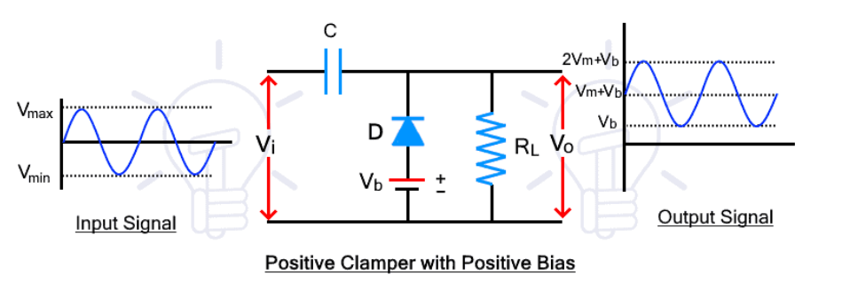
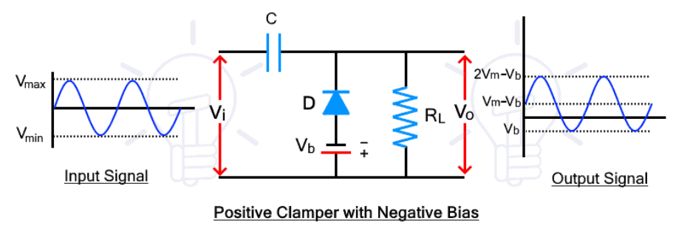
Biased Clampers Circuit
DURING -VE CYCLE: D is ON (short circuited), C will be charged to peak input voltage. Vo = 0 through ideal diode before the reference voltage Vb.
DURING + VE CYCLE: D is OFF (open circuited), output through will follow the input.
DURING -VE CYCLE: D is ON (short circuited), C will be charged to peak input voltage. Vo = 0 through ideal diode before the reference voltage -Vb.
DURING + VE CYCLE: D is OFF (open circuited), output through will follow the input.

Slide 50
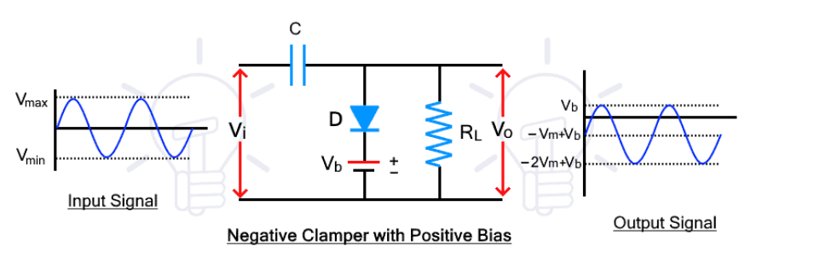
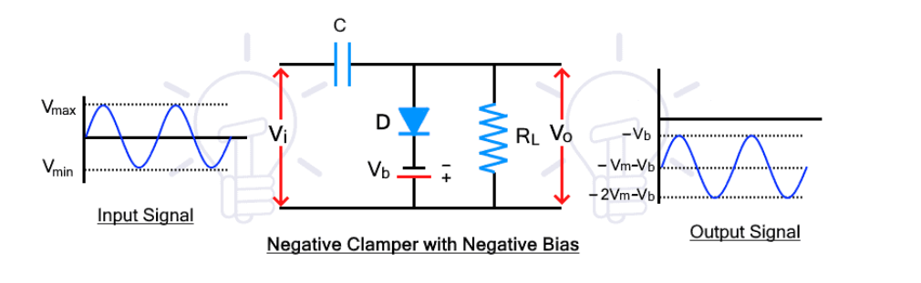
DURING +VE CYCLE: D is ON (short circuited), C will be charged to peak input voltage. Vo = 0 above Vb.
DURING - VE CYCLE: D is OFF (open circuited), output through will follow the input.
DURING +VE CYCLE: D is ON (short circuited), C will be charged to peak input voltage. Vo = 0 above – Vb
DURING - VE CYCLE: D is OFF (open circuited), output through will follow the input.

Slide 51


Slide 52


Slide 53


Slide 54
Clippers Applications
Clampers Applications
Used for the generation and shaping of waveforms
Used for the protection of circuits from spikes
Used for amplitude restorers
Used as voltage limiters
Used to remove distortions
Used as voltage multipliers
Used for the protection of amplifiers
Used as base-line stabilizer

Slide 55
CLIPPER
A circuit that clips the input signal at a specified level above or below is called a clipper. A clipper that clips the positive half-cycle of an input signal is called a positive clipper. A clipper that clips the negative half-cycle of an input signal is called a negative clipper.
Clippers
series clippers
shunt clippers.

Slide 56


SERIES CLIPPERS
SERIES POSITIVE
SERIES NEGATIVE

Slide 57


SHUNT CLIPPERS
SHUNT POSITIVE
SHUNT NEGATIVE

Slide 58


SERIES POSITIVE BIAS POSITIVE
SHUNT POSITIVE BIAS POSITIVE
DURING -VE CYCLE: D is ON (short circuited), output through R will follow the input.
DURING +VE CYCLE: D is OFF (open circuited), output through R = battery voltage = V b
DURING +VE CYCLE: D is ON (short circuited), output through D = Vb
DURING -VE CYCLE: D is OFF (open circuited), output through will follow the input.

Slide 59


SERIES POSITIVE BIAS NEGATIVE
SHUNT POSITIVE BIAS NEGATIVE
DURING -VE CYCLE: D is ON (short circuited), output through R will follow the input till battery voltage –Vb.
DURING +VE CYCLE: D is OFF (open circuited), output through R = 0.
DURING +VE CYCLE: D is ON (short circuited), output voltage through D in ideal scenario= 0
DURING -VE CYCLE: D is OFF (open circuited), output through will follow the input after –Vb..

Slide 60


SERIES NEGATIVE: BIAS POSITIVE
SHUNT NEGATIVE: BIAS POSITIVE
DURING +VE CYCLE: D is ON (short circuited), output through R will follow the input till battery voltage Vb.
DURING -VE CYCLE: D is OFF (open circuited), output through R = 0 till battery voltage.
DURING -VE CYCLE: D is ON (short circuited), output voltage through D will be 0 till battery voltage Vb.
DURING +VE CYCLE: D is OFF (open circuited), output through will follow the input.

Slide 61


SERIES NEGATIVE: BIAS NEGATIVE
SHUNT NEGATIVE: BIAS NEGATIVE
DURING +VE CYCLE: D is ON (short circuited), output through R will follow the input.
DURING -VE CYCLE: D is OFF (open circuited), output through R is 0 after -V b
DURING -VE CYCLE: D is ON (short circuited), output through 0 before - Vb
DURING +VE CYCLE: D is OFF (open circuited), output through will follow the input.

Slide 62



Slide 63

FOR PRACTICAL DIODE

Slide 64


